Slide 1
13/14. Merger Review and Litigation
Class Slides
Antitrust Law
Fall 2014 Yale Law School
Dale Collins

Slide 2
Flakeboard/SierraPine

Slide 3
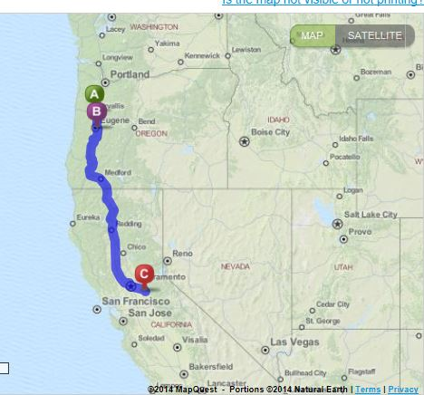
Flakeboard/SierraPine
Particleboard plants
Albany (FB)
Springfield (SP)
Martell (SP)

Slide 4
Flakeboard/SierraPine
Oregon Particleboard Mills
Boise Cascade Corp. | La Grande, OR
Collins Products | Kalmath Falls, OR
Flakeboard | Albany, OR
Lamanation Technologies | White City, OR
Panolam Industries | Albany, OR
Roseburg Forest | Roseburg, OR
Roseburg Forest | Dillard, OR

Slide 5
Hertz/Dollar Thrifty

Slide 6
Hertz/Dollar Thrifty
Very drawn out acquisition dance
April 26, 2010: | Hertz to buy at $1.2 billion
July 28, 2010: | Avis offers $1.33 billion
Sept. 2, 2010: | Avis raises bid to $1.36 billion
Sept. 12, 2010: | Hertz to $1.56 billion
Sept. 27, 2010: | DT rejects Avis bid
Sept. 30, 2010: | DT rejects Hertz bid
Bidding continues
May 9, 2011: | Hertz offers $2.1 billion
Aug. 21, 2011: | DT wants best and final offers by Oct. 10
Sept. 14, 2011: | Avis pulls out of bidding
Oct. 27, 2011: | Hertz withdraws bid
Aug. 23, 2012: | DT major shareholders say they would accept a $2.4 billion bid
Aug. 27, 2012: | Sign deal at $2.3 billion

Slide 7
Hertz/Dollar Thrifty
Rental Car Companies
Hertz | Hertz, Advantage
Avis | Avis, Budget
Dollar Thrifty | Dollar, Thrifty
Enterprise | National, Alamo, Enterprise

Slide 8
Hertz/Dollar Thrifty
Rental Car Companies
 |  | % | HHI
Hertz | Hertz, Advantage | 26% | 676
Avis | Avis, Budget | 35% | 1225
Dollar Thrifty | Dollar, Thrifty | 12% | 144
Enterprise | National, Alamo, Enterprise | 25% | 625
 |  |  | 2670
Avis/Enterprise |  | 60%
4CFR |  | 98%
Combined |  | 38%
Premerger HHI |  |  | 2670
Delta |  |  | 624
Postmerger HHI |  |  | 3294

Slide 9
Merger Litigation

Slide 10
Plaintiffs and forums
Plaintiff | Trial Forum | Appeal
DOJ | Federal district court | Court of appeals
FTC –Preliminary inj. –Permanent inj. | Federal district court FTC administrative trial | Court of appeals Full commission, then any court of appeals with venue
State AGs* | Federal district court | Court of appeals
Private parties* | Federal district court | Court of appeals
* May bring state claims in state court or join state claims in federal court

Slide 11
Types of injunctions in merger cases
TRO | Premerger: Maintain status quo Postmerger: Hold separate/preserve assets for divestiture
Preliminary injunction | Premerger: Blocking injunctions (not hold separate) Postmerger: Hold separate/preserve assets for divestiture Recission in the right case
Permanent injunction | Premerger: Blocking injunction Postmerger: Divestiture (recission in one case)

Slide 12
Injunction standards
Tradition equitable standard for injunctive relief (private actions)
Court must consider and weigh:
the probability of the plaintiff's success on the merits
the threat of irreparable injury to the plaintiff in the absence of the injunction;
the possibility of substantial harm to other interested parties from a grant of injunctive relief; and
the interest of the public

Slide 13
Typical litigation paradigms
DOJ preclosing challenge
Litigate TRO
Interlocutory Appeal
Final Appeal
Federal district court
Complaint
Stipulate to TRO
Preliminary Injunction
Permanent Injunction
Almost always stipulated
Often consolidated under FRCP 65(a)(2)
FTC preclosing challenge
Litigate TRO
Appeal to Ct. of Appeals
Can be different circuits
Federal district court
Sec. 13(b) Complaint
Stipulate to TRO
Preliminary Injunction
Appeal to Ct. of Appeals
Almost always stipulated
FTC
Administrative
Complaint
Admin. Trial before ALJ
Appeal to Commission

Slide 14
Typical litigation paradigms
DOJ postclosing challenge
Final Appeal
Federal district court
Complaint
Permanent Injunction
FTC postclosing challenge
Appeal to Ct. of Appeals
FTC
Administrative
Complaint
Admin. Trial before ALJ
Appeal to Commission

Slide 15
Litigation timing—Preclosing challenges
 | DOJ |  |  | FTC
 | H&R Block | Oracle | Sunguard | Ardagh* | CCC
Complaint | 5/23/11 | 2/24/04 | 10/23/01 | 6/28/13 | 11/25/08
PI hearing |  |  |  | 10/11/13 (3 days) | 1/8/09 (9 days)
PI |  |  |  | ?? | 3/18/09
PI appeal |  |  |  | ??
Merits hearing | 9/6/11 (9 days) | 6/6/04 | 11/8/01 (10 hours) | 12/2/13
Live witnesses | 8 fact 3 experts |  | 3 experts
Initial merits decision (FTC) | -- | -- | -- | 4/14/14 (est)
Final decision | 10/31/11 | 9/9/04 | 11/14/01 | 7/24/14
Merits appeal | None | None | None | [add 6 months]
Total time to conclusion | 5 months | 6.5 months | 3 weeks | 13 months (wo/appeal) | 4 months
Consolidated
Consolidated
Consolidated
Transaction abandoned after PI
* Estimates based on original schedules and Commission rules

Slide 16
Litigation timing—Postclosing challenges
 | DOJ | FTC
 | Bazaarvoice | ProMedica | Polypore | Evanston | Chicago Bridge
Complaint | 1/10/2013 | 1/6/2011 | 9/10/2008 | 2/10/2004 | 10/25/2001
Merits hearing | 9/23/2013 to10/10/2013 | 5/31/2011 to 8/18/2011 | 5/12/2009 to 8/20/2009 | 2/10/2005 (8 weeks) | 11/12/2002 to 1/16/2003
Initial merits decision (FTC) | -- | 12/5/2011 | 2/22/2010 | 10/21/2005 | 6/18/2003
Final decision | 1/8/2014 (merits only) | 3/22/2012 | 12/13/2010 | 4/28/2008 (remedy) | 1/6/2005
Total time to final decision | 12 months | 14.5 months | 17 months | 50 months | 38.5 months
Merits appeal | (none) | 4/22/2014 | 7/11/2012 | (none) | 1/25/2008
Total time to conclusion | 12 months | 39.5 months | 46 months | 50 months | 75 months
* Estimates based on original schedules and Commission rules

Slide 17
Strategic litigation behavior at the FTC
Poster child: Coca-Cola/Dr Pepper (1986-1995)
Jan. 23, 1986 PepsiCo (27.4%) agrees to acquire Seven-Up (6.3%)
Feb. 21, 1986 Coca-Cola (38.6%) agrees to acquire Dr Pepper (7.1%)
June 24, 1986 PepsiCo and Seven-Up terminate transaction in light of FTC opposition
June 24, 1986 FTC files Section 13(b) complaint against Coca-Coca/Dr Pepper
July 15, 1986 FTC files administrative complaint against Coca-Coca/Dr Pepper
July 15, 1986 PepsiCo acquires Seven-Up International (and splits brand)
July 31, 1986 District court enters PI enjoining transaction
Aug. 6, 1986 Dr Pepper terminates Coca-Cola purchase agreement
Aug. 20, 1986 Dr Pepper sold to Hicks & Haas-led investor group
Oct. 3, 1986 Seven-Up Co. sold to Hicks & Haas-led investor group
Nov. 30, 1990 ALJ issues initial decision (finding liability but denying relief)—both sides appeal to full Commission
June 13, 1994 Full Commission issues final decision (vacating denial of relief and entering order requiring prior approval of the FTC before acquiring any interest in a company that manufactures or sells branded concentrate, syrup, or carbonated soft drinks in the United States)
Aug. 26, 1994 Coca-Cola appeals to D.C. Circuit
May 25, 1995 FTC settles appeal by modifying order to require prior approval only if Coca-Cola acquires an interest in Dr Pepper or a Dr Pepper brand name

Slide 18
ABInbev/Grupo Modelo

Slide 19
ABInbev/Grupo Modelo
U.S. Beer (National)
 | % | HHI
ABI | 39% | 1521
MillerCoors | 26% | 676
Modelo | 7% | 49
Heineken | 6% | 36
Others (10) | 22% | 48
 | 100% | 2330
Combined | 46%
Premerger HHI |  | 2330
Delta |  | 546
Postmerger HHI |  | 2876

Slide 20
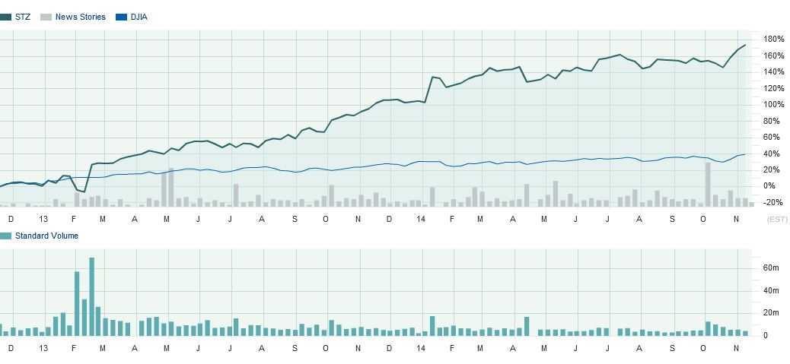
ABInbev/Grupo Modelo
Constellation Brands stock performance
Compared to the DJIA

